Slide 1
Summary data on acid cropland and lime requirements in Kenya
Joao Vasco Silva, Jordan Chamberlin, Christian Witt
www.acidsoils.africa

Slide 2
Top-10 counties with acidic cropland
(exchangeable acidity >10% ECEC)
Source: Geosurvey SoilGrids

Slide 3
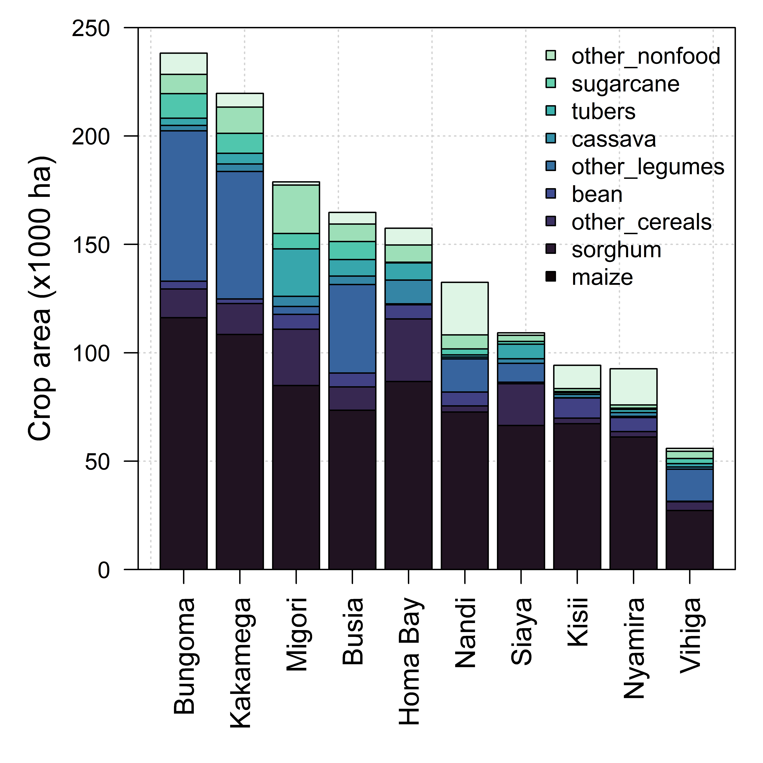
Total crop area distribution (ha)
Total crop area in the top-10 most acidic counties, not segregated by acidic cropland.
Source: MapSPAM

Slide 4
Additional production (t) and value (US$)
Background tabular data provided as MS Excel file.
Data to refer to additional production and value only, irrespective of profitability.
Source: MapSPAM
SoilGrids
FAOSTAT

Slide 5
Yield loss (%) for maize and bean

Slide 6
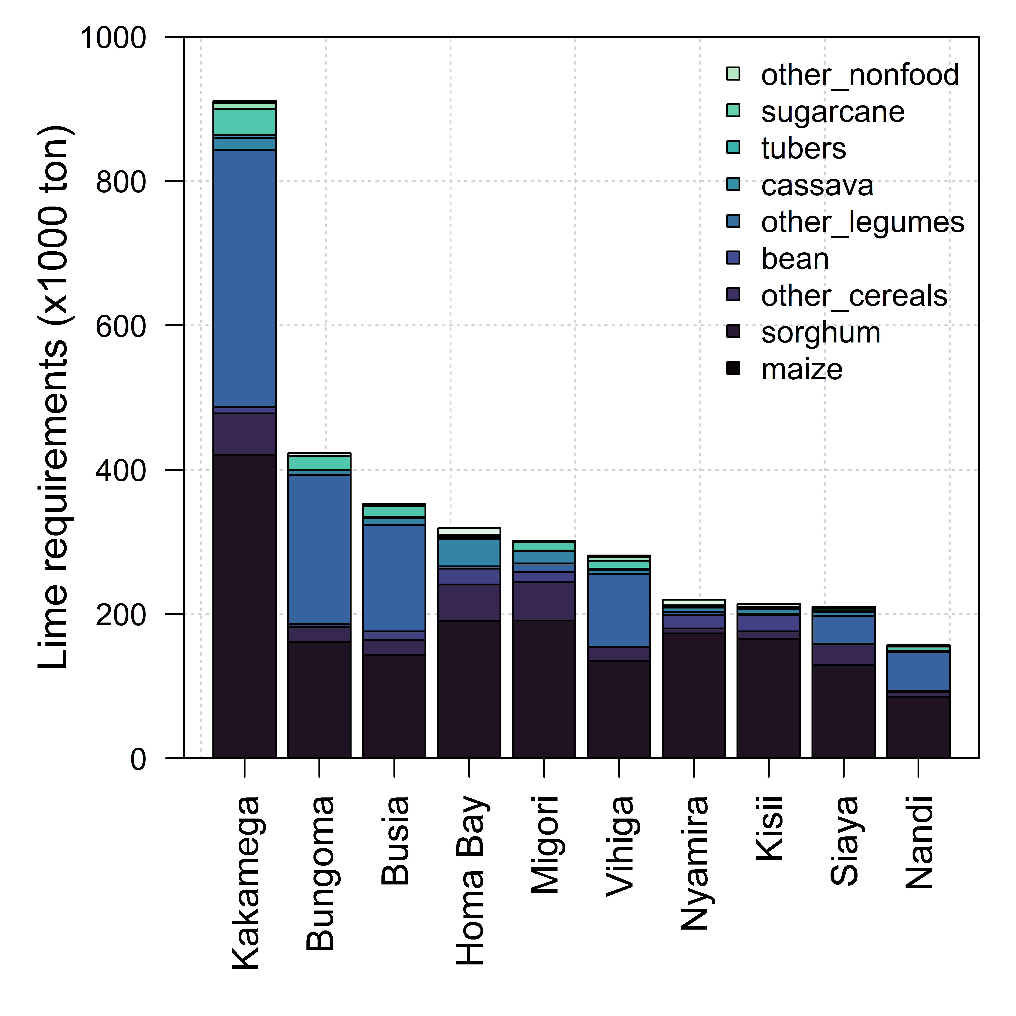
Lime requirements (t) for acid soil remediation
Lime requirements to alleviate acid soil constraints above 10% of ECEC.
Source: MapSPAM
SoilGrids

Slide 7
Lime rates (t/ha) for maize and bean

